Slide 1

Sports Analytics
Gowtham R
Olympic Sports Analysis Report

Slide 2
Introduction & Objectives
Objective of the Project
The purpose of this analysis is to explore and extract meaningful insights from historical Olympic data. The focus is on understanding:
Trends across Olympic seasons (Summer vs. Winter)
Participation patterns by gender, age, and region
Sports and event distributions
Medal allocations and host city patterns
Scope of Analysis
Covers multiple Olympic editions from 1896 onward.
Explores data on games, participants, sports, medals, cities, and regions.
Answers 18 analytical questions using Power BI.
Combines related or similar results into 9 unique and meaningful visual summaries.

Slide 3
Deliverables
A Power BI dashboard with 9 key analytical visuals (consolidated from 18 questions).
A concise, presentation-ready report highlighting key insights and findings.

Slide 4
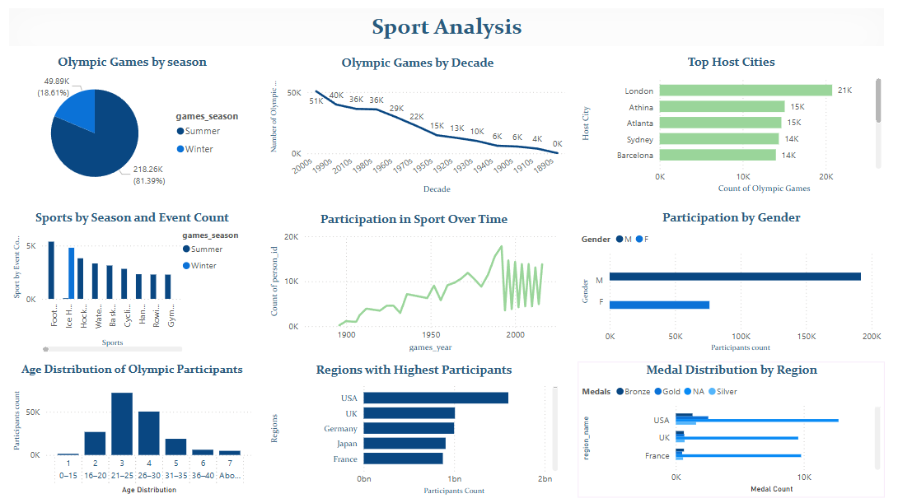
Overview of Dashboard

Slide 5
Insight Summary
The dashboard provides a clear visual understanding of how the Olympic Games have evolved over time in terms of participation, hosting, sports representation, and regional achievements.

Slide 6
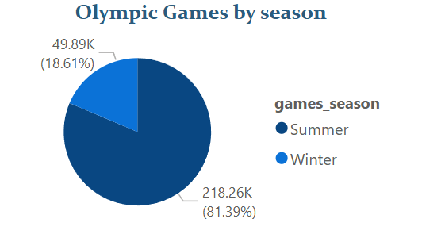
Olympic Games by Season
Key Insights: Summer Olympics dominate with 81.39% of total events. Winter Olympics account for only 18.61%.
Conclusion: The Summer Olympics host a significantly higher number of games and participants, reflecting broader event coverage and global appeal.

Slide 7
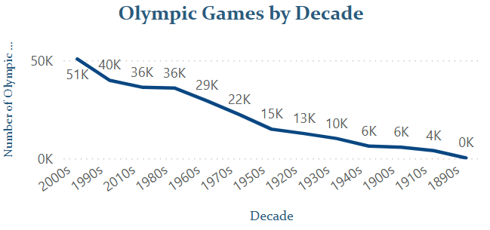
Olympic Games by Decade
Key Insights: Peak activity observed in the 2000s (51K). Participation steadily declined back through early 20th century.
Conclusion: The Olympic Games have seen a consistent upward trend in participation and events over the decades, particularly post-1950s.

Slide 8
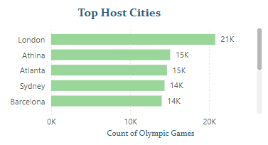
Top Host Cities
Key Insights: London is the top host with 21K recorded. Athina and Atlanta both hosted around 15K events.
Conclusion: Certain cities like London have repeatedly hosted the Games, indicating strong infrastructure and historical Olympic ties.

Slide 9
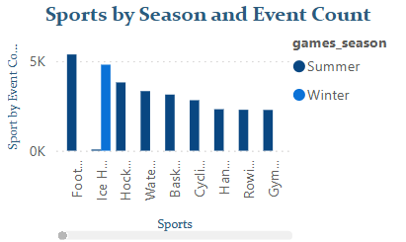
Sports by Season and Event Count
Key Insights: Football, Ice Hockey, and Hockey are among the top sports by event count. Summer sports generally feature more events than Winter sports.
Conclusion: Summer Olympics offer a broader array of sports, explaining their dominance in participation and viewership.

Slide 10
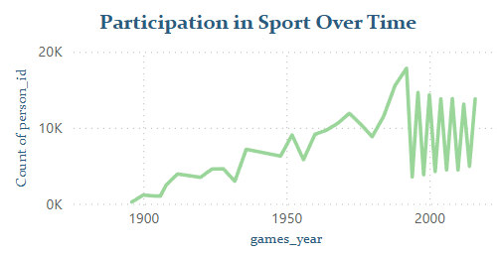
Participation in Sport Over Time
Key Insights: Steady increase from 1900 onward. Sharp growth from 1950s to early 2000s.
Conclusion: Olympic participation has grown significantly, reflecting increased global engagement and inclusiveness.

Slide 11
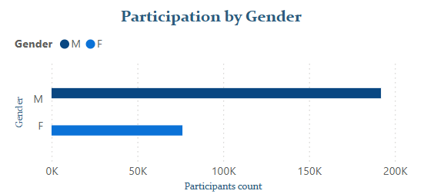
Participation by Gender
Key Insights: Male athletes far outnumber female athletes. Gender gap persists but may be narrowing over time.
Conclusion: Gender inequality in participation still exists, suggesting more efforts are needed to promote women's representation in sports.

Slide 12
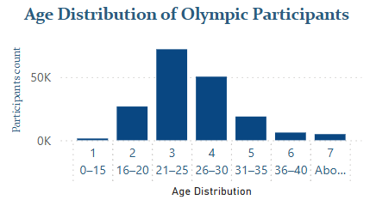
Age Distribution of Olympic Participants
Key Insights: Highest concentration in 21–25 age group. Very low participation in under 15 and above 40 age brackets.
Conclusion: Olympic athletes predominantly compete in their 20s, aligning with peak physical performance age.

Slide 13
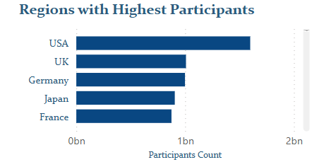
Regions with Highest Participants
Key Insights: USA leads significantly in participant count. UK, Germany, Japan, France follow closely.
Conclusion: Developed nations with strong sports infrastructure dominate Olympic participation.

Slide 14
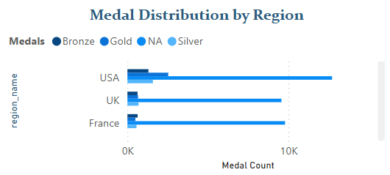
Medal Distribution by Region
Key Insights: USA has the highest medal count in all three categories: Gold, Silver, Bronze. Other regions like UK and France show balanced medal contributions.
Conclusion: The USA maintains historical dominance in Olympic performance, showing success across diverse sports.

Slide 15
Conclusion
This analysis explored over a century of Olympic history using Power BI.
18 questions were addressed and consolidated into 9 key visuals for better clarity.
The dashboard provided interactive insights into participation, medal distribution, host cities, age, gender, and seasonal trends.

Slide 16
Key Takeaways
Summer Olympics dominate in frequency and diversity of sports.
Olympic participation has grown steadily, with major growth after 1950.
Male participation still leads, but female athlete numbers are rising.
Most athletes are aged 21–30, aligning with peak performance age.
USA consistently leads in both participation and medal counts.
London is the top host city, reflecting historical importance.
Medal distribution varies by region, but a few countries dominate.

